Slide 1
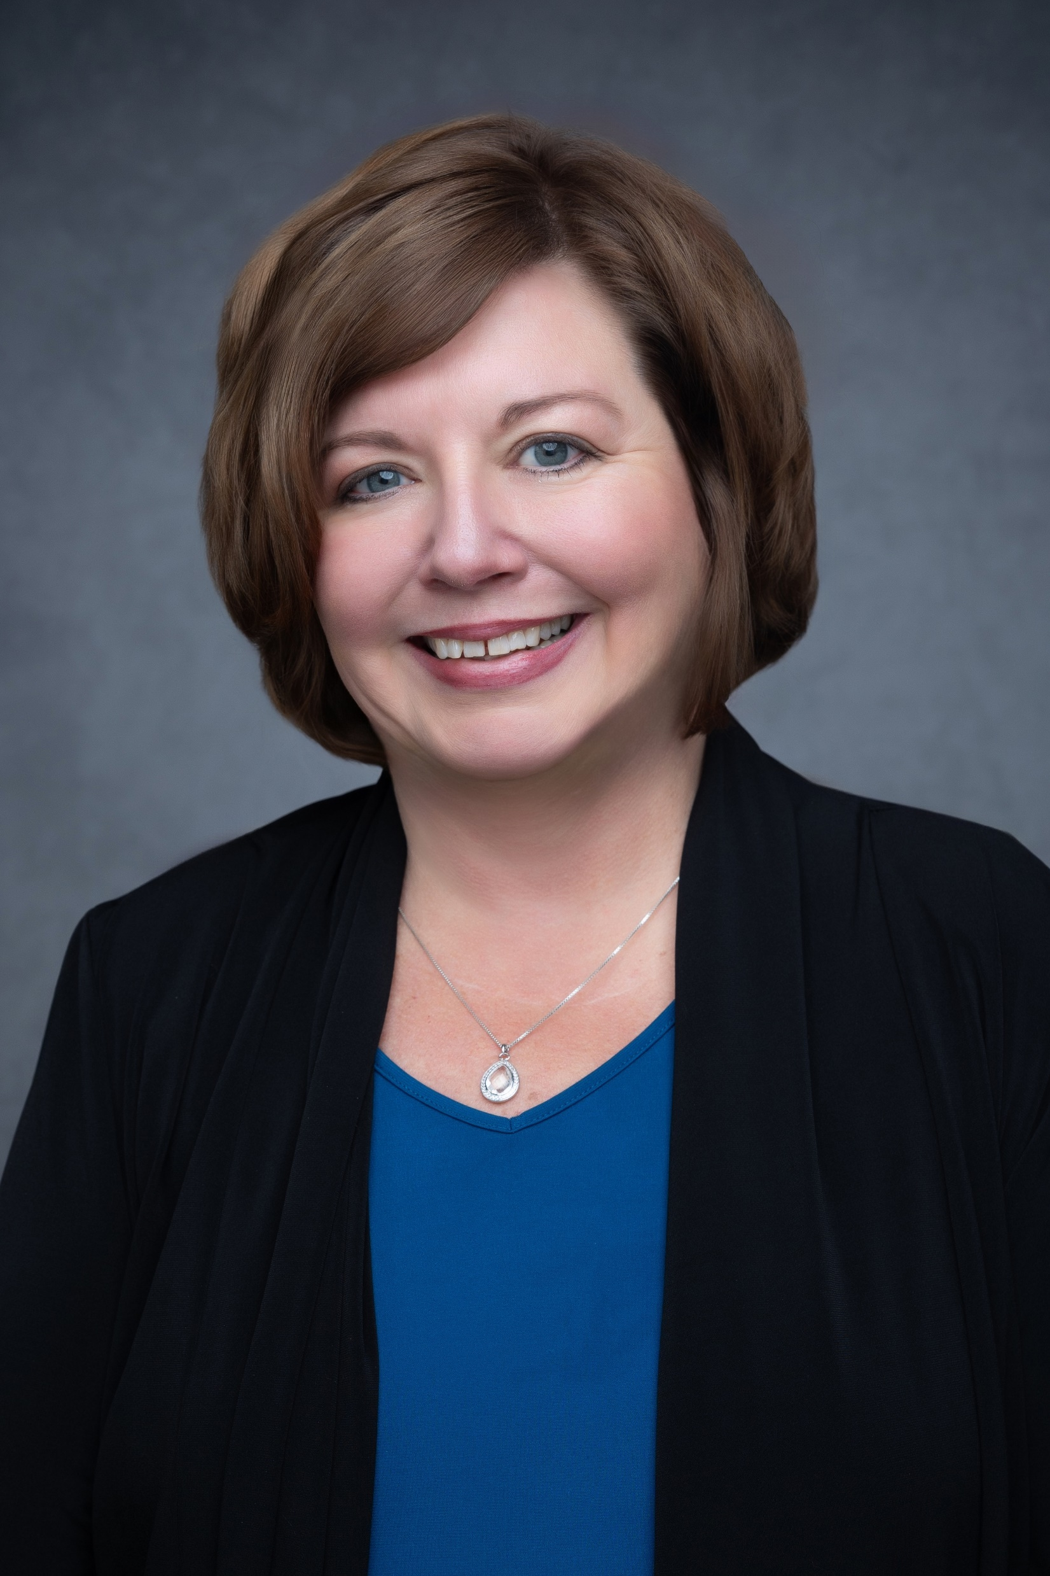
Jana Gessert
Senior Consultant
Email
jana.gessert@thebridge.com
Location
St. Louis, MO
Mobile
(636) 578-9041
Jana joined The Bridge in June 2024. She has worked in many facets of the healthcare realm including clinical, sourcing, medical manufacturing, medical distribution and group purchasing.
EXPERIENCE
Industry Experience
Healthcare Acute|Non Acute|Supply Chain|Respiratory Therapy|Advanced Wound Care|Medical Distribution|Medical Device
Strategic Sourcing
Large Acute Care Systems
Non Acute
Custom Sourcing
Strategic Program Development
Supplier Programs
Non Acute- Hospice, Ambulatory Surgery Centers, Long Term Care, Urgent Care, Women’s Health
Emergency Management Programs
New Technology
Sustainability
Supplier Diversity
BACKGROUND
Functional Skills
Customer relationship management ,Program Development, Strategic Sourcing, Supplier relationship management.
Qualifications
Product Director, Senior Director Strategic Programs, Strategic Sourcing, Healthcare sales and account management

